Slide 1

Flowcharts
Asst. Prof. Dr. Derya BİRANT

Slide 2
OUTLINE
What is Flowchart?
Flowchart Symbols
Flowchart Examples

Slide 3
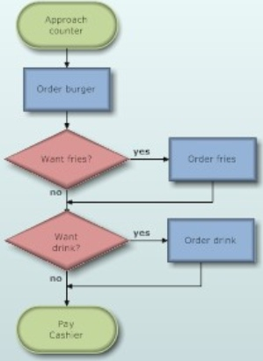
What is Flowchart?
Flow charting is a diagrammatic representation of the problem solving process.
All steps are laid out in logical order.

Slide 4
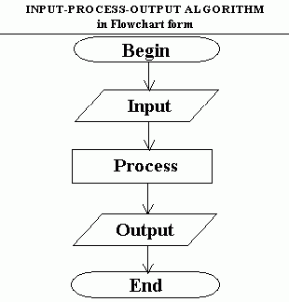
What is Flowchart?

Slide 5
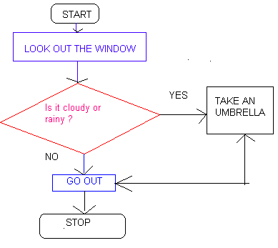
Example Flowchart

Slide 6

Flowchart Symbols
START
Start – End The terminator symbol marks the starting or ending point of the system. It usually contains the word "Start" or "End." Start (0 input, 1 output) End (At least 1 input, 0 output)
END
Action or Process A box can represent a single step or and entire sub-process within a larger process (At least 1 input, 1 output)
Input – Output Represents information entering or leaving the system, such as user inputs or a display operation. (At least 1 input, 1 output)
Decision It’s usually in the form of a yes/no question. Branches flow lines depending upon the answer. (At least 1 input, 1 output)
False
True
Arrows (Flow Lines) Flow lines indicate the sequence of steps and the directions of the flow.
Connector Indicates that the flow continues where a matching symbol has been placed.

Slide 7
Programming Control Structures
Sequential Control
Selection Control
Iteration Control
Sequential Control Selection Control Iteration Control
Statement 1
Statement 2
Condition
Condition
Statement(s)
...
Yes
No
No
Statement n
Yes

Slide 8
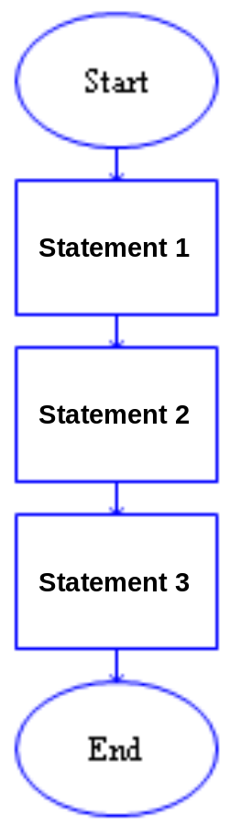
Sequential Control
Execute statements, one after the other, in the order in which they appear in the program.
  After the Start statement,
  The first statement of a program is executed,
  Then the second statement is executed,
  The third is executed,
  and so on until the End is reached.

Slide 9
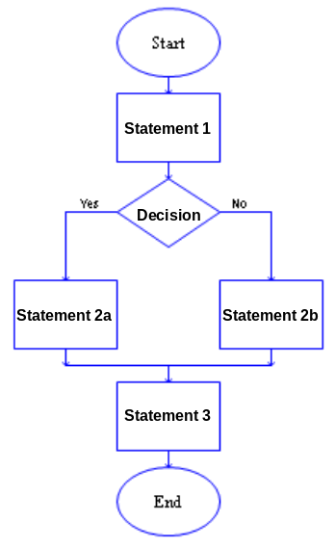
Selection Control
Controls whether or not a collection of code is executed or which collection of code is executed.
The diamond shape represents a decision that when executed could result in an answer of Yes OR No (True or False).
In the example, either statement 2a or statement 2b will be executed.
One of them will be executed, but not both.
However, statement 3 will always be executed.

Slide 10
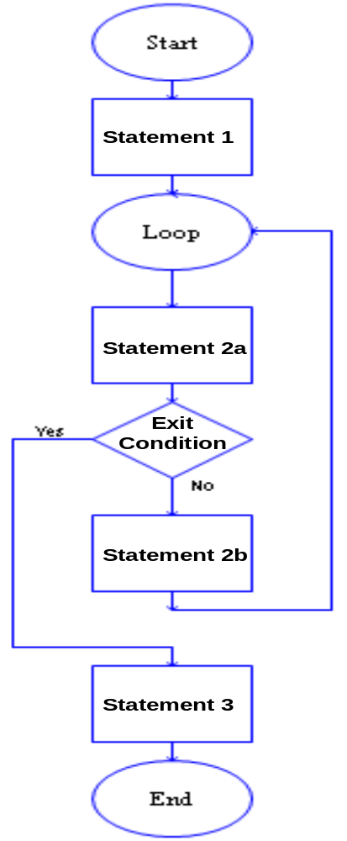
Iteration Control
It controls how many times a block of code is executed.
Execute some code until a condition occurs.
Statement 1 and statement 2a are always executed.
If the exit condition is true, then the loop exits and statement 3 is executed.
If the exit condition is false the statement 2b and then statement 2a are executed and the exit condition is checked again.
As long as the exit condition is false, statement 2b and then statement 2a will be executed again and again.

Slide 11

Example 1
The area of the field
Read width
Read length
area ← width * length
Write area
Start
Read (width)
Read (length)
area = width * length
Write Area
length
Stop
width

Slide 12
Example 2
The average of three numbers.
Read the first number (A)
Read the second number (B)
Read the third number (C)
Average ← (A + B + C) / 3
Write Average
Start
Read (A)
Read (B)
Read (C)
Average = (A + B + C) / 3
Write Average
End

Slide 13
Questions
Draw a flowchart to convert the Celsius to Fahrenheit.
100 Cº = 212 Fº
(F = 9/5C +32)

Slide 14

Example 3
Check the student pass the exam or not.
Note: Grade must be greater than 60.
Start
Read Grade
Grade
<60?
Yes
Write “not pass”
90
40
No
Write “pass”
End

Slide 15
Example 4
Find that the given number is less than, greater than or equal to 200.
Start
Read Number
Number
<200?
Yes
Write “less than 200”
No
Number
=200?
Yes
Write “equal to 200”
No
Number
>200?
Yes
Write “greater than 200”
No
End

Slide 16
Questions
Draw a flowchart to find the maximum number between 2 numbers.
Draw a flowchart to determine given number is odd or even.

Slide 17
Example 5
Draw a flowchart which writes “World Peace!!” 100 times.
World Peace!!
World Peace!!”
World Peace!!”
World Peace!!” 100 times
...
....
World Peace!!”
Start
i=0
i=100?
Yes
End
No
Write “World Peace!!”
i = i + 1

Slide 18
Example 6
Draw a flowchart that sums the numbers between 1 and 100.
Start
Sum=0
i =0
i = i +1
Sum = Sum + i
i=100?
False
True
Write Sum
End

Slide 19
Question
Draw a flowchart that finds the factorial 10.

